Slide 1
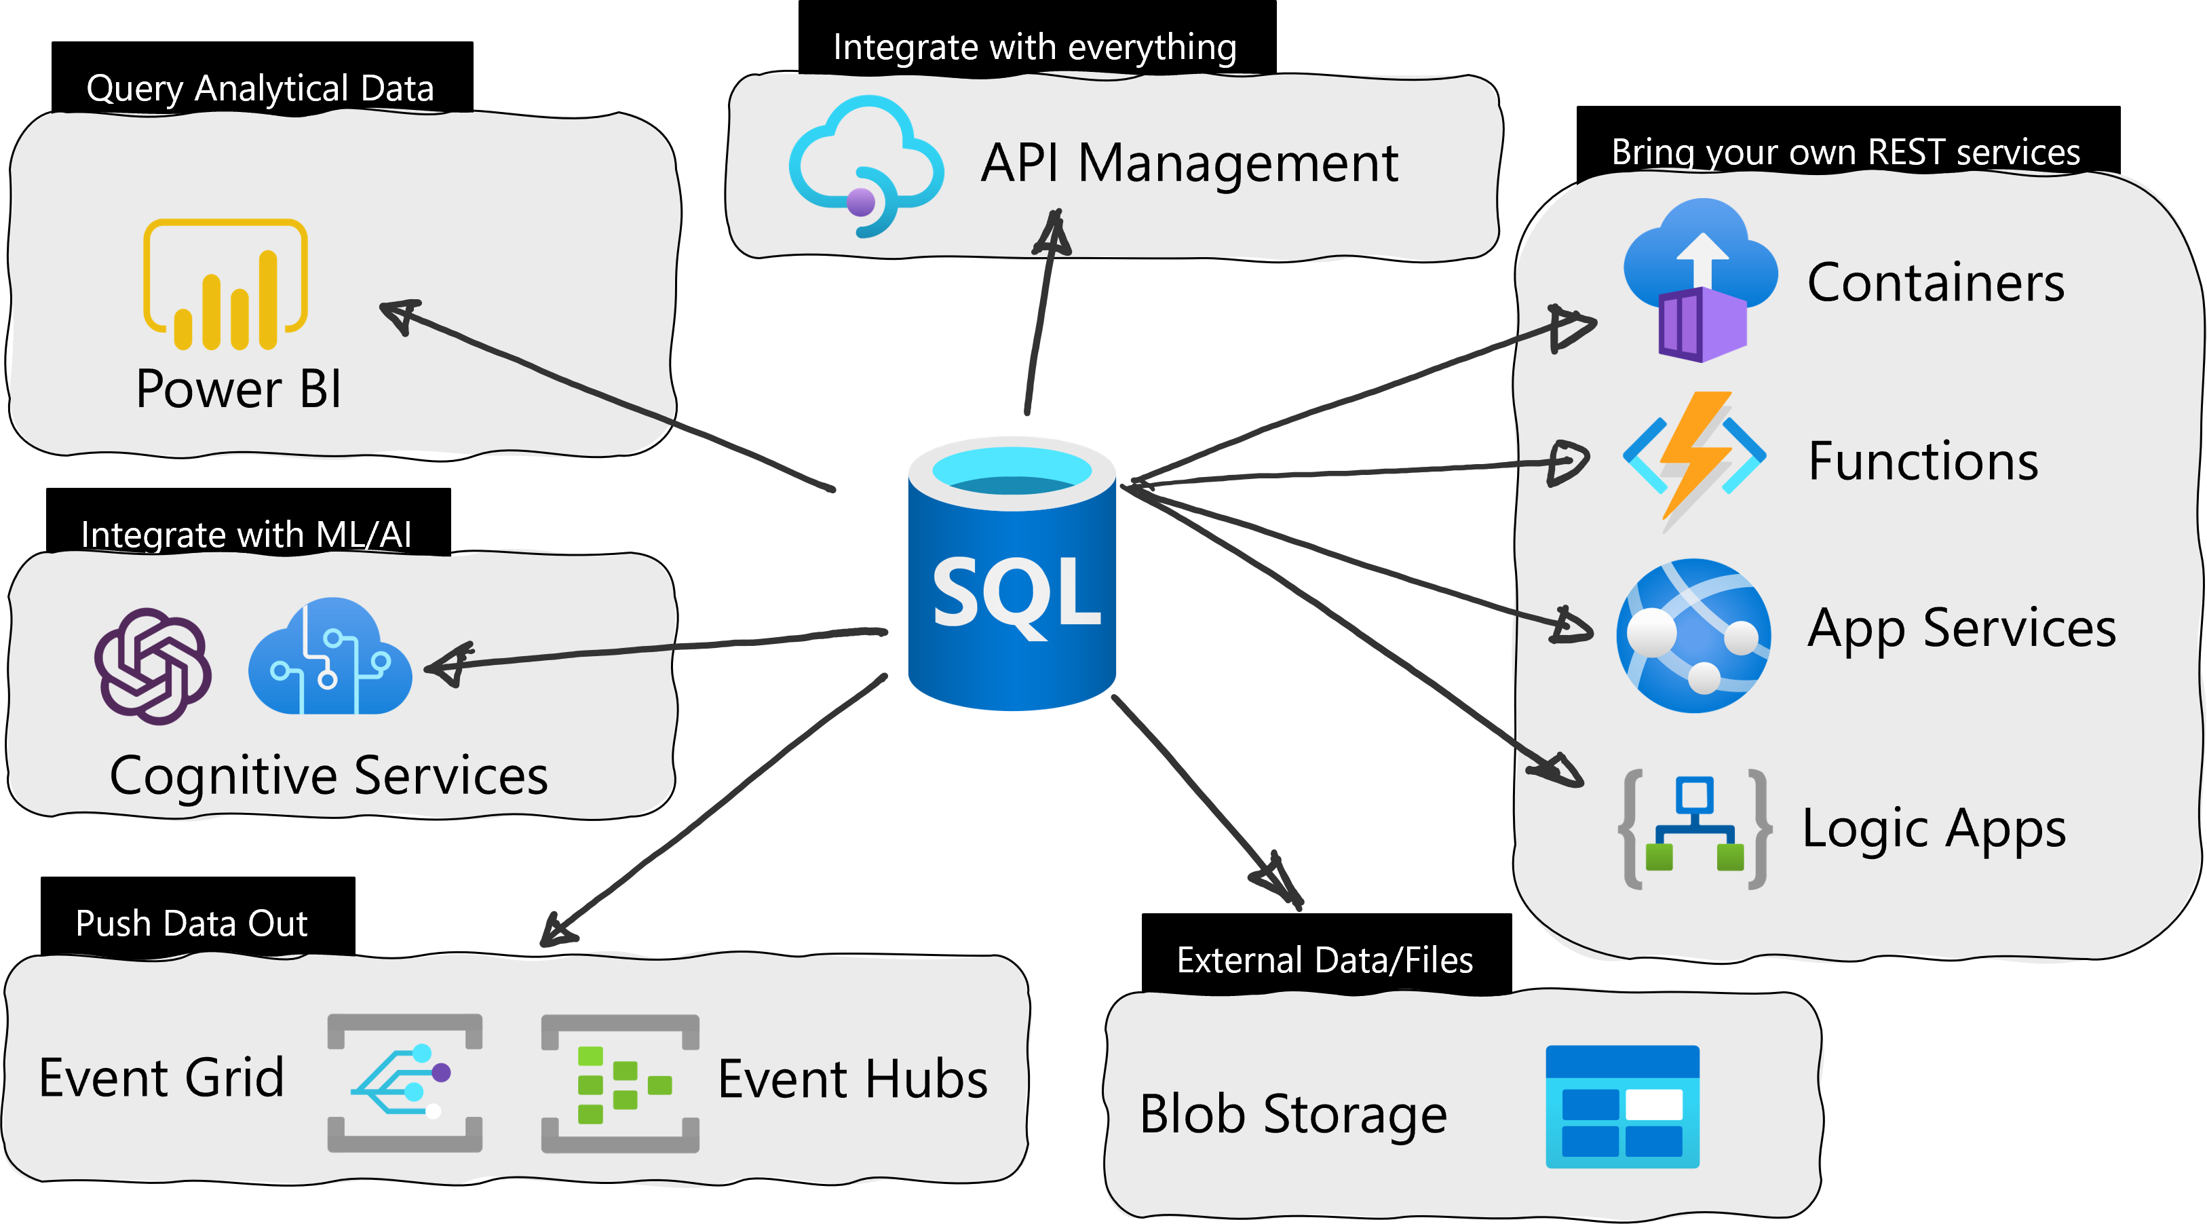
REST endpoint invocation

Slide 2
Examples
Interaction with a storage account:
Azure FileShare
Azure Container
Interaction with external resources:
Azure API Management

Slide 3
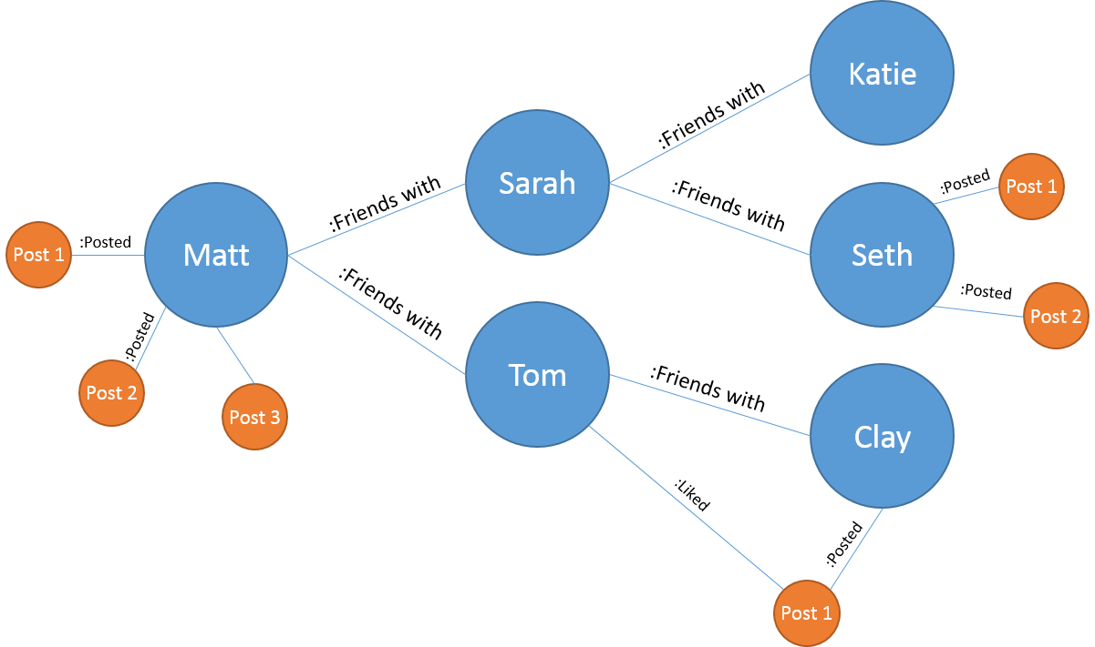
Graph Database on SQL Server
When should we use it?
Highly interconnected data
Flexible data scheme
Ease of access
Graph processing - SQL Server and Azure SQL Database | Microsoft Learn

Slide 4
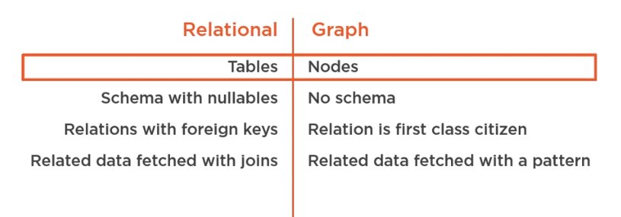
Relational vs Graph DB
A relational DB performs better when:
Data are highly structured
Computation are required on the single table
Analytics developed using group by

Slide 5
The social model
LocatedIn
Taco Dell (Restaurant)
John (Person)
Likes
LivesIn
FriendsOf
Bellevue (City)
Mary (Person)
Seattle (City)
Ginger and Spice (Restaurant)
Alice (Person)
Jacob (Person)
Redmond (City)
Julie (Person)
Noodle Land (Restaurant)

Slide 6
Questions
Find Restaurants that John likes
Find Restaurants that John’s friends like
Find people who like a restaurant in the same city they live in

Slide 7
Forum model – highly interconnected
Mike (ForumMember)
Likes
Carl (ForumMember)
Paul (ForumMember)
Christy (ForumMember)
Jennifer (ForumMember)
Charlie (ForumMember)
John (ForumMember)
Steve (ForumMember)

Slide 8
SHORTEST_PATH
Specifies a search condition for a graph, which is searched recursively or repetitively. SHORTEST_PATH can be used inside MATCH with graph node and edge tables, in the SELECT statement.
A shortest path between two given nodes/entities
Single source shortest path(s).
Shortest path from multiple source nodes to multiple target nodes.
‘+’: repeat the pattern 1 or more times. Terminate as soon as a shortest path is found
{1,n}: repeat the pattern 1 or n times. Terminate as soon as a shortest path is found
LAST_NODE(): allow you to chain two traversal path of arbitrary length
Aggregate functions: STRING_AGG, LAST_VALUE, SUM, COUNT, AVG, MIN, MAX
SHORTEST PATH (SQL Graph) - SQL Server | Microsoft Learn

Slide 9
Forum model – highly interconnected
Reply_To
Intro (ForumPosts)
Hi there this is ABC
Mike (ForumMember)
Likes
Intro (ForumPosts)
Hello I’m PQR
Carl (ForumMember)
Paul (ForumMember)
Re: Intro (ForumPosts)
Hey PQR this is XYZ
Christy (ForumMember)
Geography (ForumPosts)
Im George from USA
Re: Geography (ForumPosts)
I’m Mary from OZ
Jennifer (ForumMember)
Charlie (ForumMember)
Re: Geography (ForumPosts)
I’m Peter from UK
John (ForumMember)
Written_By
Intro (ForumPosts)
I’m Peter from UK
Steve (ForumMember)
Intro (ForumPosts)
Nice to see all here!

Slide 10
Try you!
T-SQL (Hard Skill)
Data Factory (Hard Skill)
Python (Hard Skill)
Valery (Person)
Leesa (Person)
Juliet (Person)
Lorenzo (Person)
Daycon (Person)
Frank (Person)
Saam (Person)

Slide 11
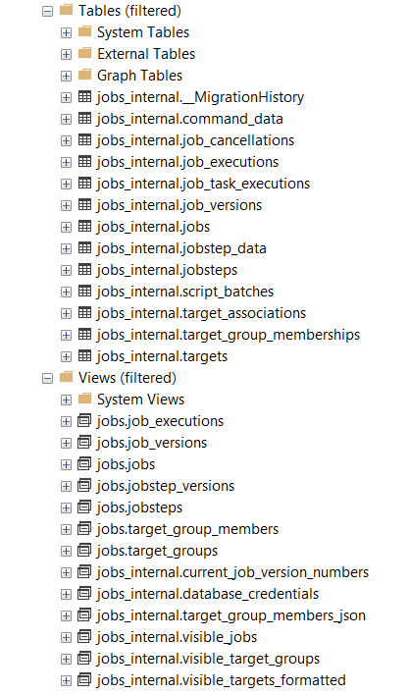
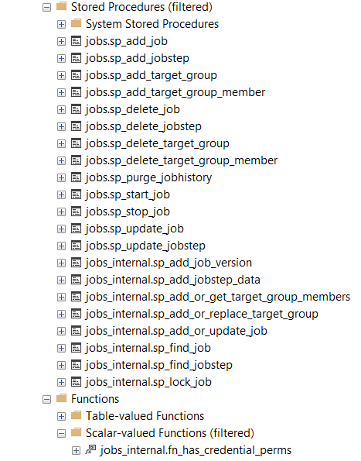
Elasticjobs: schema jobs_internal

Slide 12
